Slide 1


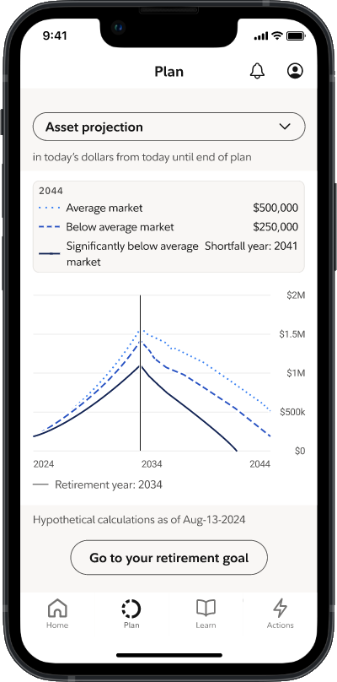
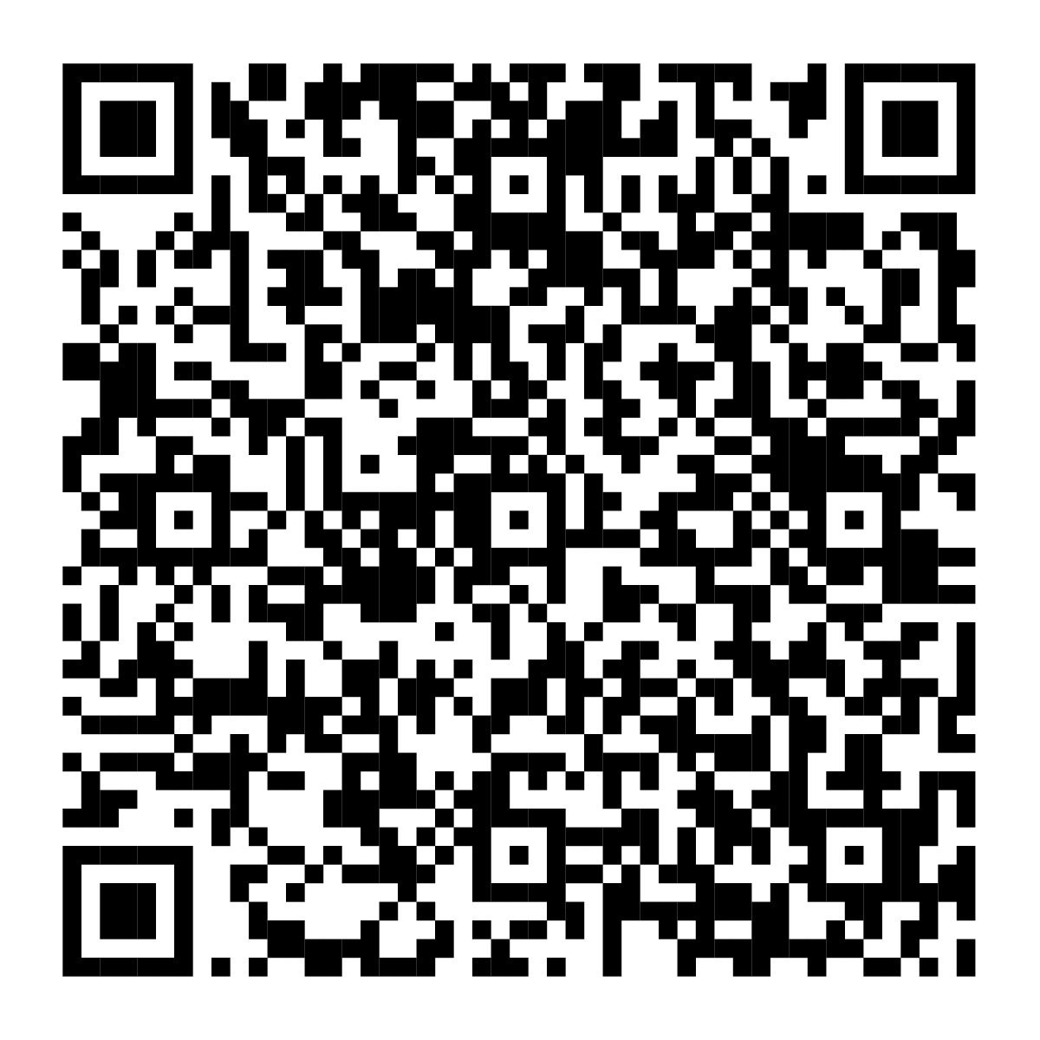

Financial Capability Month
Help to make better money decisions.
Visit your Financial Wellness Dashboard on NetBenefits® during Financial Capability Month—and all year long—
for tools and educational resources to help you continue making progress on your money goals.
To view your dashboard, scan the code
or visit NetBenefits.com/dashboard.
Screenshot is for illustrative purposes only.
NetBenefits and the Fidelity Investments logo are registered service marks of FMR LLC.
Fidelity Brokerage Services LLC, Member NYSE, SIPC, 900 Salem Street, Smithfield, RI 02917
© 2026 FMR LLC. All rights reserved. 1246850.1.0

